Slide 1
Abstract
Flight ticket fare is the most fluctuating data which varies every day. Depending on the various factors that affect it directly or indirectly. we cannot say that the price of flight ticket fare remains the same or not. It is quite a tough task to predict the flight ticket fare. It may change throughout the week, month or some days, but it can be predicted nearly accurate to the actual flight ticket fare.
The prime objective of our project "Improved Flight Prediction System" is to make a prediction of the flight ticket fare for the future flights. The proposed approach is using machine learning algorithm and we are using supervised learning.
The regression model which we have selected for our prediction is “Extreme Gradient Boosting”. In this approach we have developed this project in python language for backend. For the GUI Bootstrap, HTML, CSS using django framework and python using tKinter.

Slide 2
Introduction
Nowadays, the airline corporations are using complex strategies for the flight ticket fare calculations. This highly complicated methods makes the flight ticket fare difficult to guess for the customers, since the fare changes dynamically.
Our project Improved Flight Price Prediction System which resolve this problem and provide a facility where people will be able to predict the flight-ticket price before purchasing the ticket.

Slide 3
Approach
The proposed approach is using machine learning algorithm and we are using supervised learning.
We are gathering our data from a site. The data is containing some of the details of Indian flight of a short duration.
This project involves the feature engineering for processing the dataset (data) to convert it into dataframe. When we have the processed dataframe we move to normalizing the dataframe.
The regression model which we have selected for our prediction is Random Forest model.
We are training the model with the normalized datafame. After experimenting and tuning the hyper parameters we are obtaining the predicted results and the accuracy

Slide 4
Objective
The prime objective of this project is to use machine learning techniques to model the behavior of flight ticket prices over the time and predict the price of the flight-ticket.
The goal of this project is to study how airline ticket prices change over time, extract the factors that influence these fluctuations, and describe how they're correlated (essentially guess the models that air carriers use to price their tickets)

Slide 5
About project
Flight ticket price is something hard to guess therefore we are presenting our model which can predict the price of upcoming flight tickets. By using machine learning we are implementing our project. Here we have applied Extreme Gradient Boosting algorithm. In our project we have created a web page which takes the input from the user. The input contains source, destination, date and the user will select the airline of whose ticket he wants to predict. After giving the input the user can view the result of predicted price which was the result of our model.

Slide 6
Scope
For purchasing an airplane ticket, the traditional purchase strategy is to buy a ticket far in advance of the flight’s departure date to avoid the risk that the price may increase rapidly before the departure date. However, this is usually not always true, airplane companies can decrease the prices if they want to increase the sales.
Airline companies use many different variables to determine the flight ticket prices that indicates whether the travel is during the holidays, the number of free seats in the plane etc., or even in which month it is, some of the variables are observed, but some of them are hidden.
In this context, buyers are trying to find the right day to buy the ticket, and on the contrary, the airplane companies are trying to keep the overall revenue as high as possible. Airline companies have the freedom to change the flight ticket prices at any moment. Travelers can save money if they choose to buy a ticket when its price is the lowest.

Slide 7
Technology Stack
Technology
Software
Machine Learning (Supervised learning).
tKinter.
Python.
HTML.
CSS.
Bootstrap.
Django (Framework)
Jupyter Notebook.
Pycharm

Slide 8
Data Collection
Data Analysis
Data Pre-Processing
Flow chart
Model Building
Model Testing
Implementation

Slide 9
Logical Data Flow Diagram(Web Page Interface)
Customer
Input: Source,
destination,
Date.
Select: Airline,
Duration,
Stops.
Prediction Flight ticket fare

Slide 10
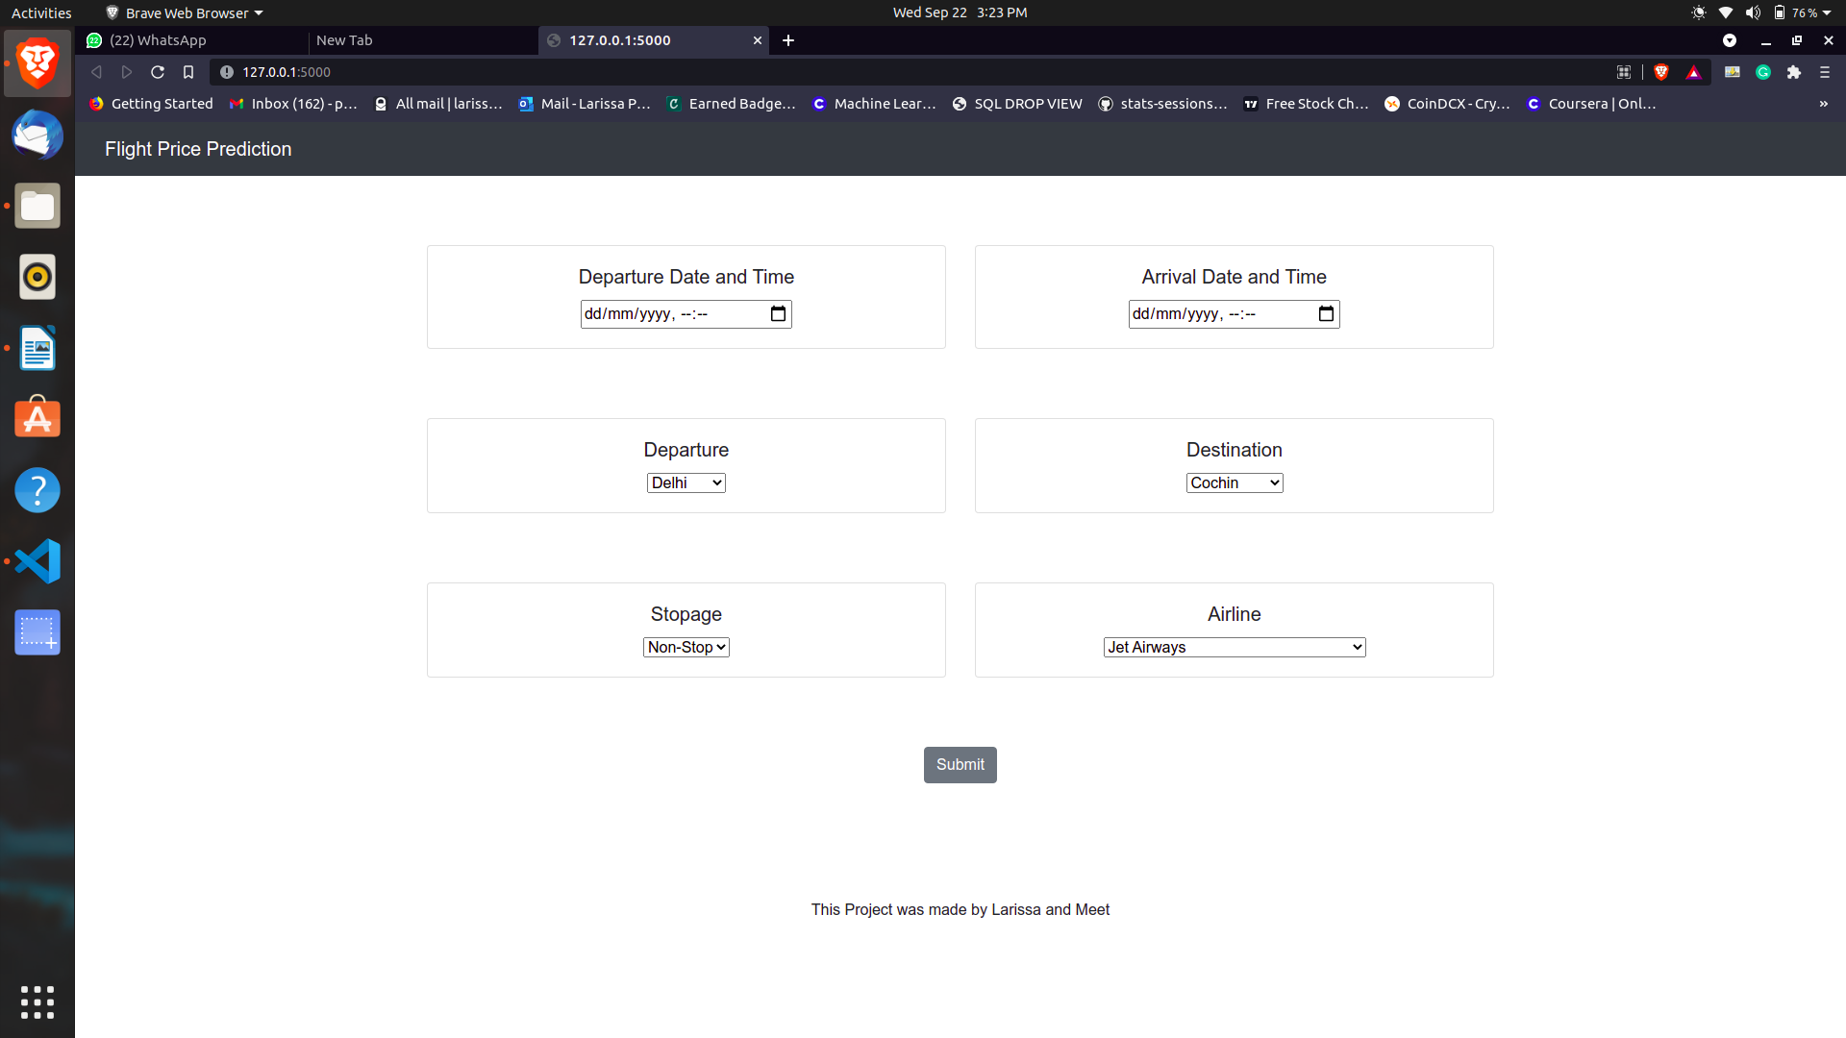
Output Screen (Web Page 1)

Slide 11
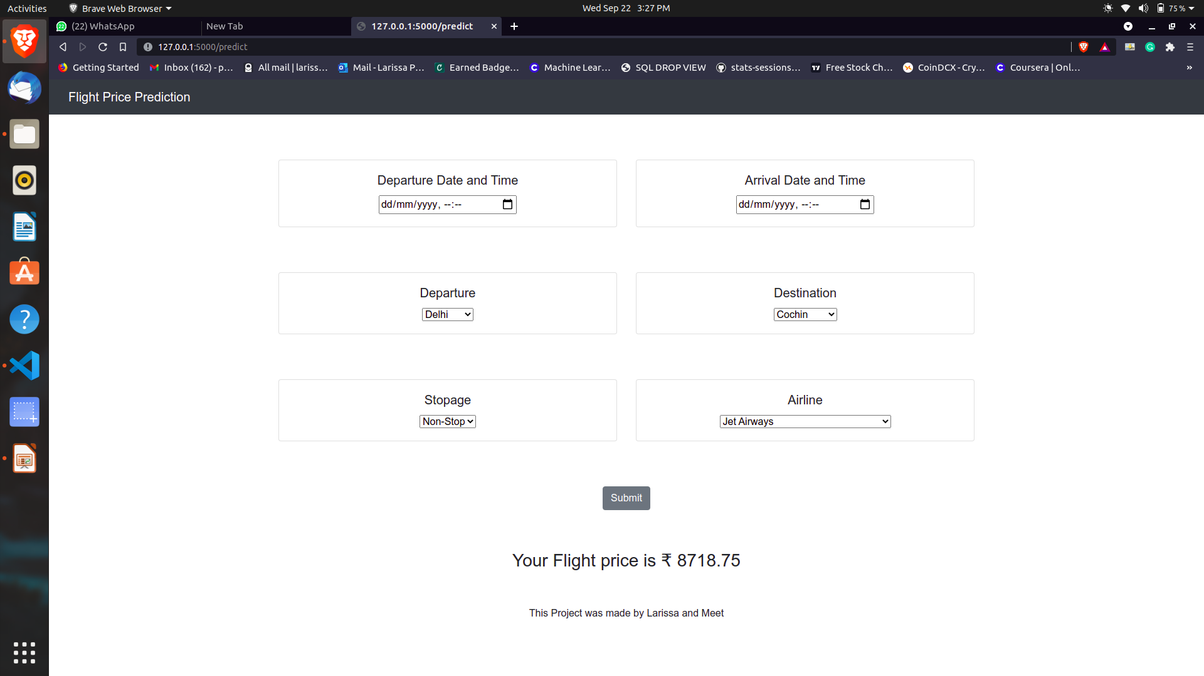
Output Screen (Web Page 2)

Slide 12
Conclusion
This System customer can predict the flight price of a particular seat on a day before booking the flight tickets. It will provide an ease to the customer for the flight ticket booking. Travelers can save money if they choose to buy a ticket when its price is the lowest. The problem is how to determine when is the best time to buy flight ticket for the desired destination and period.

Slide 13
Q & A
Q 1) What was the type of data?
The data was the combination of Numerical and Categorical values.
Q 2) What’s the complete flow you followed in this Project?
Refer slide 8th for better Understanding
Q 3) How logs are managed?
We used a single file for maintaining logs while committing information as the file runs
Q 4) What techniques were you using for data pre-processing?
Visualizing relation of independent variables with each other and output variables Checking and changing Distribution of continuous values. Converting categorical data into numeric values. Scaling the data.
Q 5) How training was done or what models were used?
We divided our data in test and train sets and then applied various models on the sets ex: XGBOOST, Decision Tree, KNN, Logistic Regression And Random Forest.
As Random Forest had the highest accuracy we proceeded with the same.

Slide 14
Thank You.

